Slide 1
Cognition Fundamentals: Decision-making & Actions
How do we learn from our perceptions?
Responsible Lecturer: Bram Heijligers

Slide 2
What we learn and why
Learning Objectives
Sample relevant real-world input required for situational awareness & reinforcement learning.
Sample cognitive processes used to process relevant real-world input required for situational awareness & reinforcement learning.
Using situational awareness & reinforcement learning to respond to make a decision and respond with a action.
→ feeds into our reinforcement learning algorithm & symbolic AI and helps to optimize it
→ how we process input and take appropriate action on it
→ how we execute the bin-picking task

Slide 3
What is situational awareness?
The ability to identify, process, and comprehend the critical elements of information about what is happening
Types:
Conscious
Subconscious

Slide 4
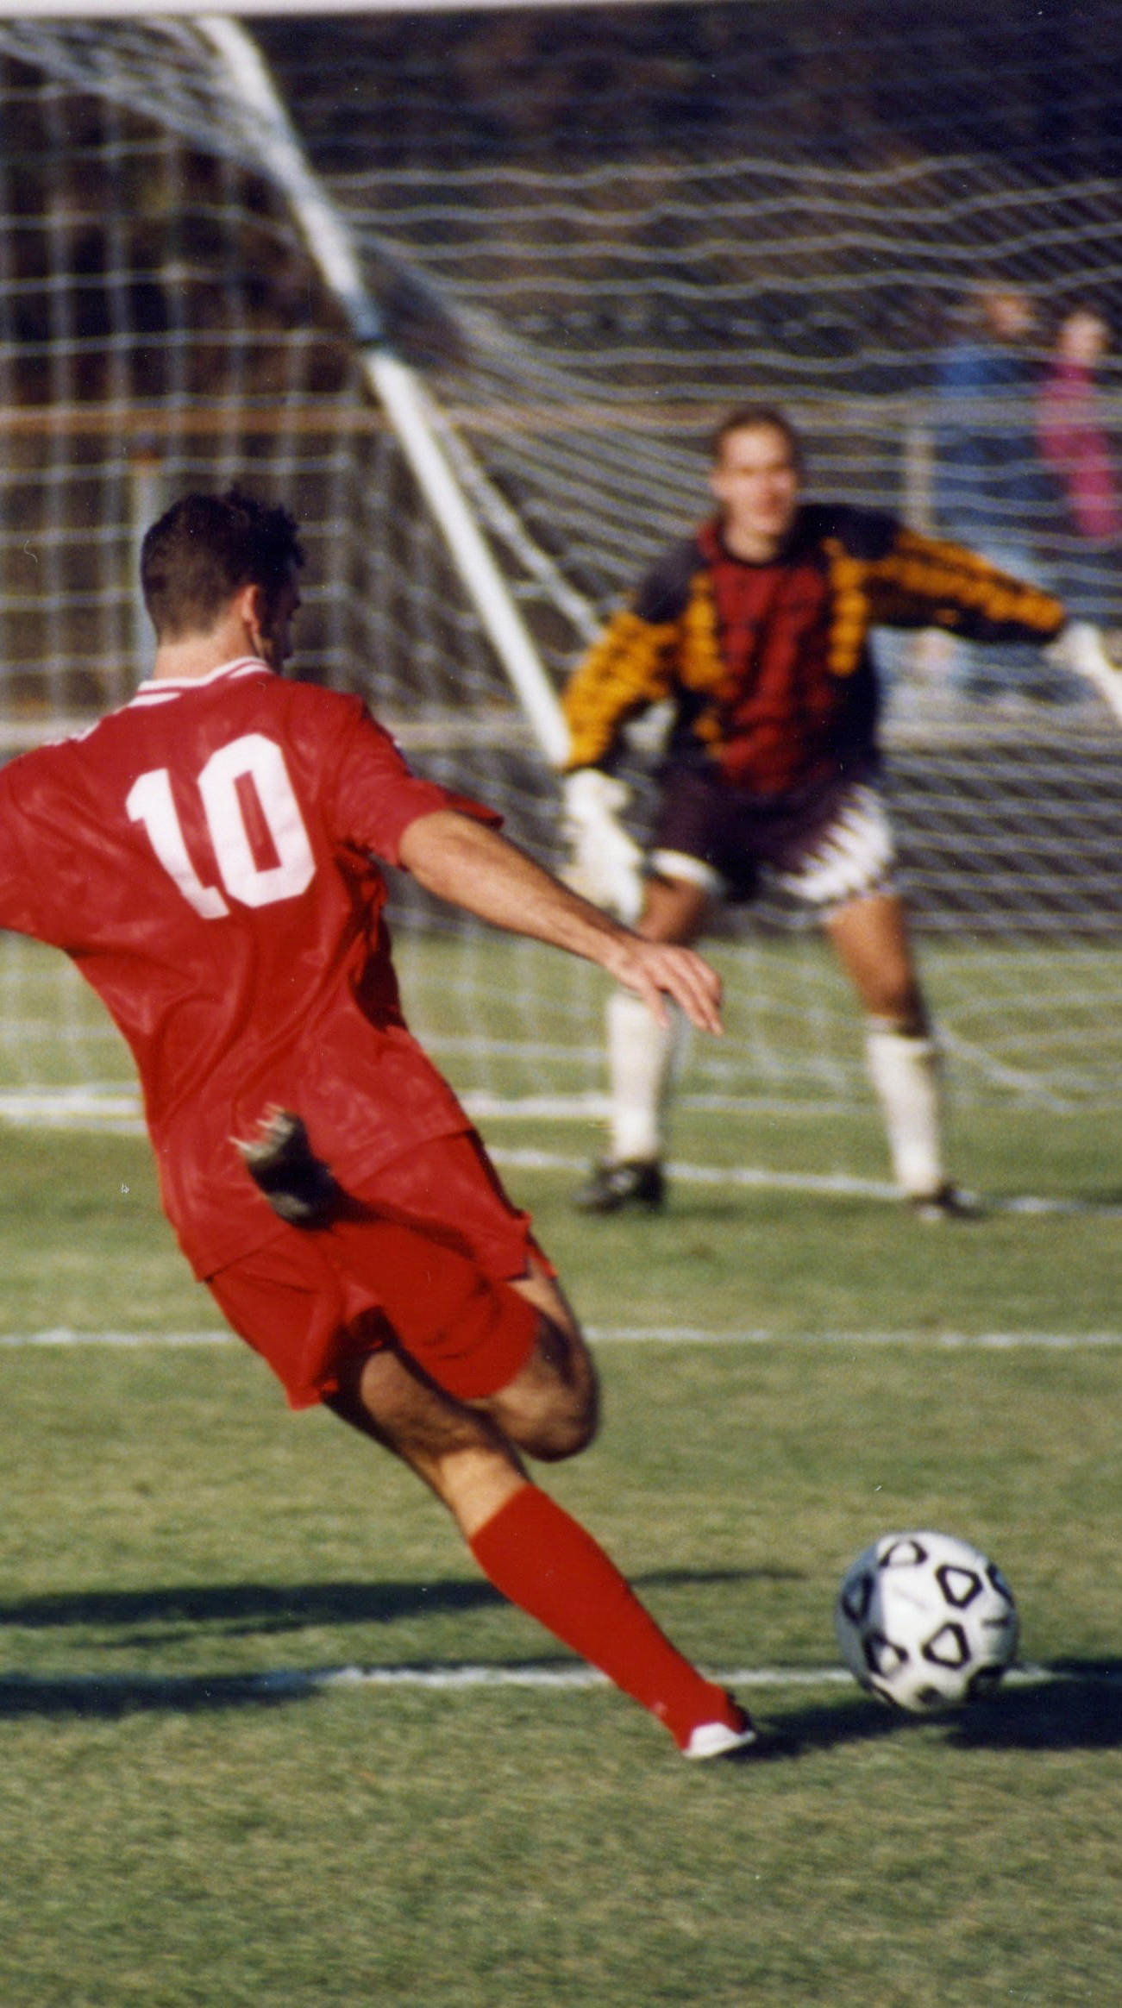
Conscious situational awareness?
“Most of the processing in the brain is not available to conscious inspection” (Styles, p. 6)
Attention
Selection of a subset of information for further processing
Depending on the sensory stimulus (visual, auditory, multisensory…)
Active (controlled by individual’s goals) vs. Passive (controlled by external stimuli) – top-down vs. bottom-up
Focused (selective - sustained) vs. Divided (multitasking)
Internal (internal processes; endogenous) vs. External (external stimuli; exogenous)
Processing resources allocated to perform a cognitive task
Outcome of processing that allows us to process certain input
Control of attention also involves (executive) action…

Slide 5
How do I achieve situational awareness
What input do we need to understand a given situation?
Conscious vs. unconscious information processing (Salti, Harel, & Marti, 2019)
3 factors that influence this process:
Context; what we already made
Conceptual understanding of the individual elements of the environment
Prior-knowledge of relevant/sampled individual elements
Causal relationships between the relevant/sampled individual elements
Stimulus saliency
Observer’s goals

Slide 6
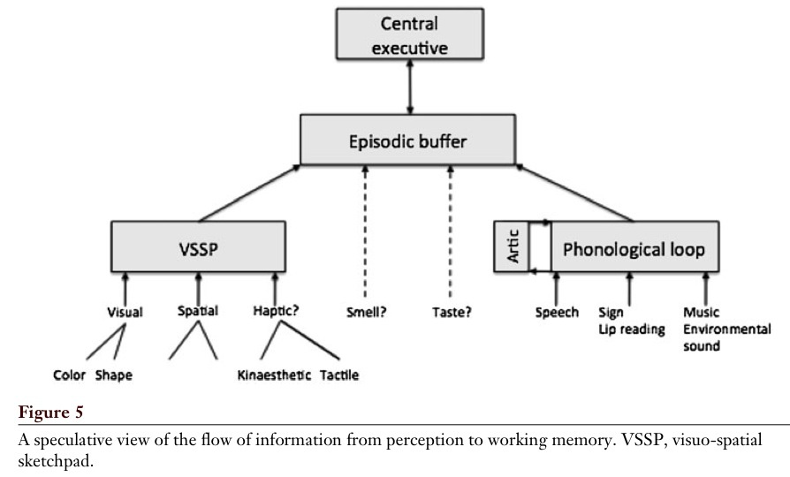
Working Memory for Perception
Baddeley, 2012

Slide 7
Central executive
Most important component of WM
Has limited capacity, deals with demanding cognitive tasks, resembles attention
Is related to executive processes (processes that organize and coordinate the functioning of the cognitive system to achieve current goals)
Baddeley (1996 – cf. Miyake et al.):
- focusing attention or concentration
- dividing attention between two stimulus streams
- switching attention between tasks
- interfacing with long-term memory

Slide 8
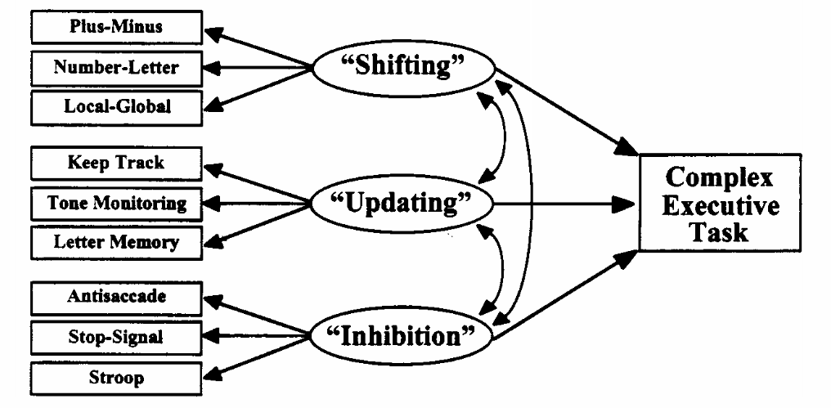
Executive Functions
Notes:
So the is the executive function that coordinates and controls other cognitive processes, such as memory, attention, and problem-solving. It is responsible for the planning and execution of tasks, the ability to switch between tasks, the ability to monitor performance, inhibit inappropriate responses, and regulate emotions.

Slide 9
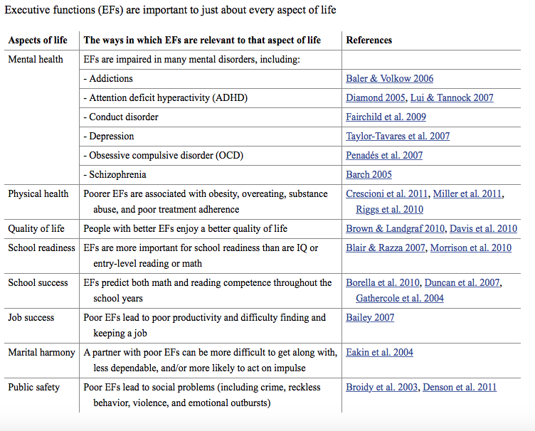
Executive Functions

Slide 10
Multisensory Challenges
Two fundamental computational challenges that the brain faces: what am I perceiving?
Causal inference problem: Do signals come from common sources and should they thus be integrated?
E.g. Bayesian causal inference
Perceptual inference problem: Assuming a common signal source, what is the relative reliability of each unisensory feature? (think of visual and auditory cues to specific phonemes)
E.g. Rubber hand illusion
Gottlieb, 2018

Slide 11

Rubber Hand Illusion

Slide 12
Conditional Probabilities
Essentially, perception is constantly asking; what is reality? Or better said, which possible version of reality is most probable?
Our senses can deceive us!
Drawing without replacement (reducing the set of possible outcomes)
P(A|B) – probability of event A assuming B
In general: P(A|B) ≠ P(A)

Slide 13
Conditional Probabilities
Bayesian inference: update probabilities as new information becomes available
Bayes’ Theorem:
P(B|A) • P(A)
P(A|B) = ________________
P(B)
Prior probability
(A before we observed B)
Posterior probability
(A after we observed B)
Probability
of observing B
Probability
of observing B given A (likelihood)

Slide 14
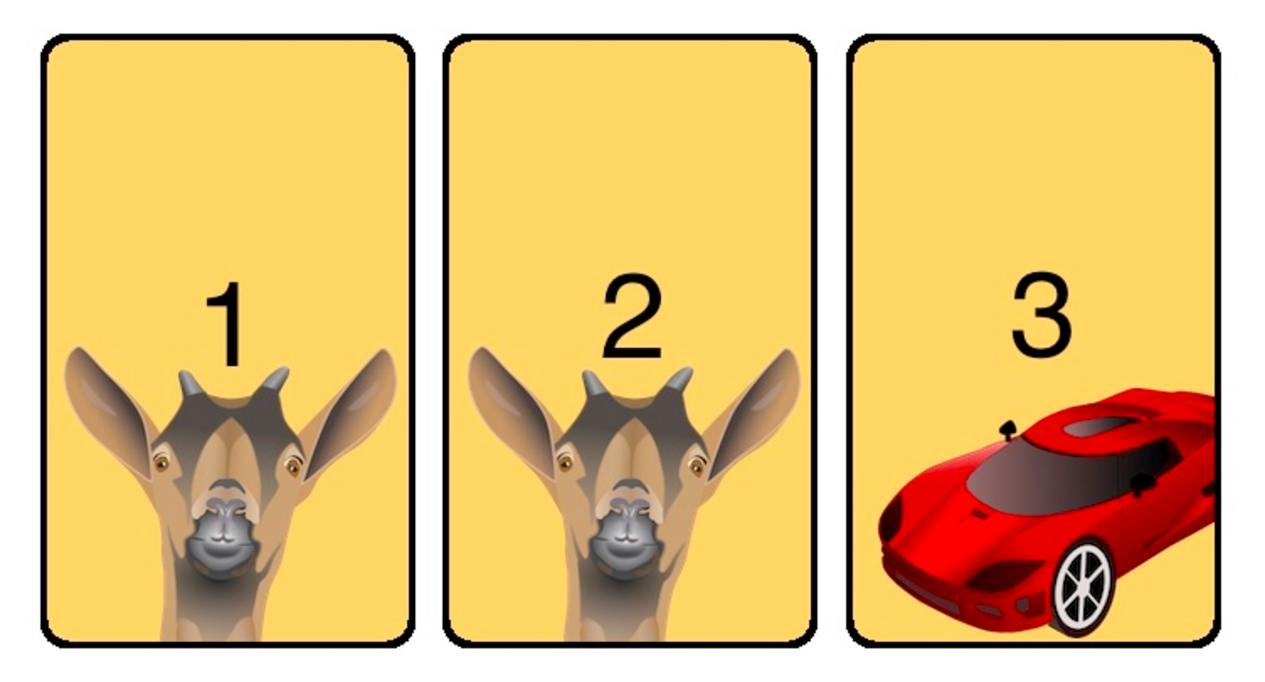
Monty Hall Problem

Slide 15
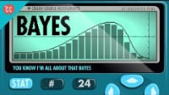
Conditional Probabilites
Nice examples, stop at 7:18’ish
Click for more on Bayes in ML!
Bayesian RL?

Slide 16
LTM: Familiarity vs. Recollection
How then is information computed in the long-term memory?
Familiarity – observer knowing an item is old or new, without having specific details associated with that memory; the process of recognizing an item on the basis of its perceived memory strength but without retrieval of any specific details about the study episode
Recollection – observer accessing specific details about a previously experienced item

Slide 17
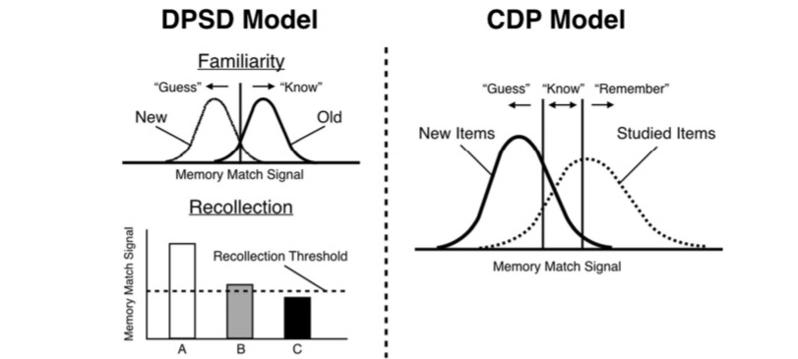
Familiarity vs. Recollection: The DPSD and CDP Models
Notes:
DPSD = dual-process signal-detection
The dual-process signal-detection (DPSD) model assumes that recognition memory is based on recollection of qualitative information or on a signal-detection-based familiarity process.
CDP = continuous dual process
The dual-process theory of recognition memory holds that recognition ‘decisions’ can be based on either recollection or familiarity, and the gues/know/remember procedure is seen as continuous flow and see recollection as a stronger form of familiarity.
What’s important to remember is that the signals stored in the long-term memory is compared to that in the working-memory.

Slide 18
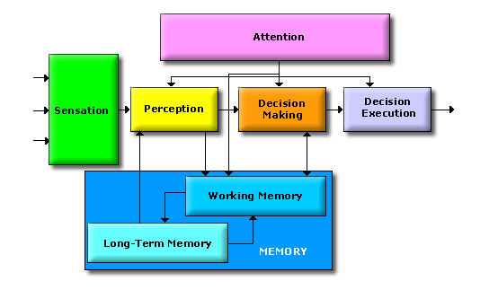
What is decision-making?
Decision-making is the process of making choices by analyzing information and evaluating possible outcomes. This process includes identifying and defining a problem, gathering information, generating solutions, evaluating alternatives, making a choice, and implementing a decision.
Dependent on:
situational awareness;
the (un)certainty of the environment and processes within;
planning & inferences;
agent motivation/goal;
More?

Slide 19

Cut at 5:50

Slide 20


Rewards & Motivation
Maslow’s Hierarchy of needs → metacognition is outside of course scope
Motivation is what motivates us; lies at the base of intelligence
Reinforcement Learning is learning what to do and how to map situations to actions. The end result is to maximize the numerical reward signal. The learner is not told which action to take, but instead must discover which action will yield the maximum reward.

Slide 21
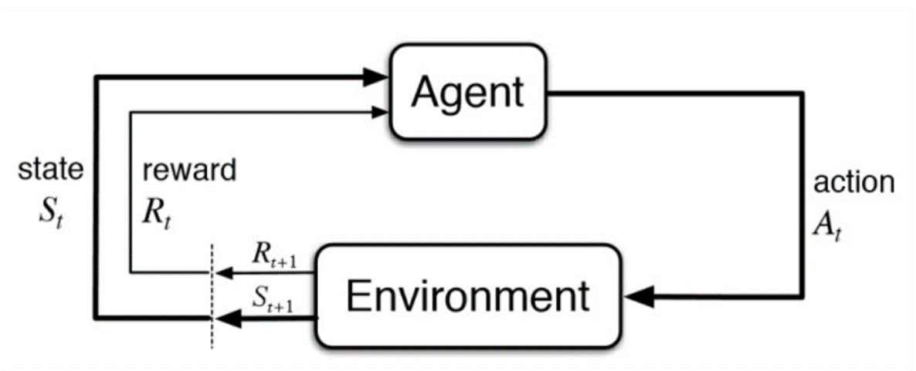
Reinforcement Learning
What happens in our cognitive and robotics model is located inside the agent bubble. However, these agent per definition interact with their environment. How are we going to incorporate the environment in our flowchart?
Notes:
Reinforcement Learning is learning what to do and how to map situations to actions. The end result is to maximize the numerical reward signal. The learner is not told which action to take, but instead must discover which action will yield the maximum reward.

Slide 22
Active Sampling
A type of cognitive strategy in which a person actively engages with their environment in order to acquire new knowledge or information. Can include:
intentional exploration of unfamiliar surroundings;
taking part in activities that provide new experiences;
and actively seeking out new sources of information
Active sampling is seen as a more efficient way for people to learn and acquire new knowledge as it involves actively engaging with the environment rather than passively absorbing information.

Slide 23
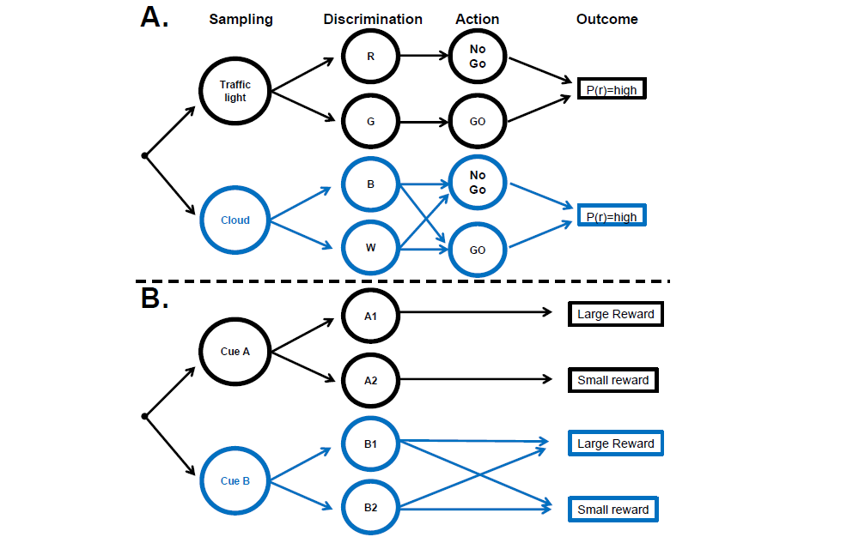
Decision chains for sampling and action
Gottlieb, 2018

Slide 24
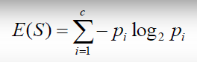
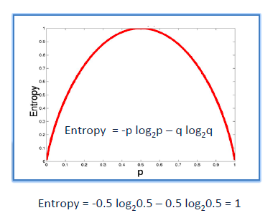
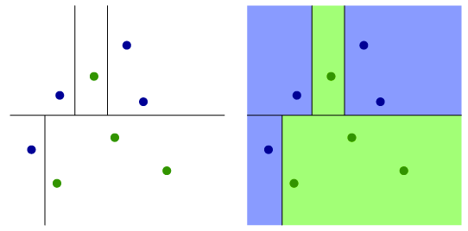
Information gain/Reduction of Uncertainty
It is like playing “20 questions”
ENTROPY = measure of disorder of a system
Zero entropy ~ completely homogeneous sample
Entropy = 1 ~ the sample is equally divided
ENTROPY
Notes:
Information gain is the process of learning from new information or experiences. It is a fundamental aspect of cognition, as it allows us to acquire new knowledge, revise existing beliefs and make decisions more effectively. Information gain occurs when new facts or concepts are added to existing knowledge, resulting in a better understanding of a particular situation or subject. Information gain can be measured by the amount of new knowledge or understanding that a person is able to acquire during their active sampling process.

Slide 25
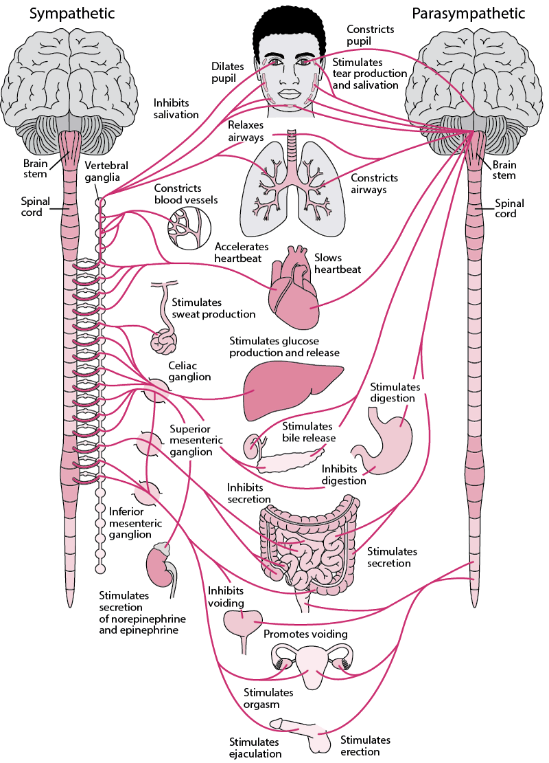
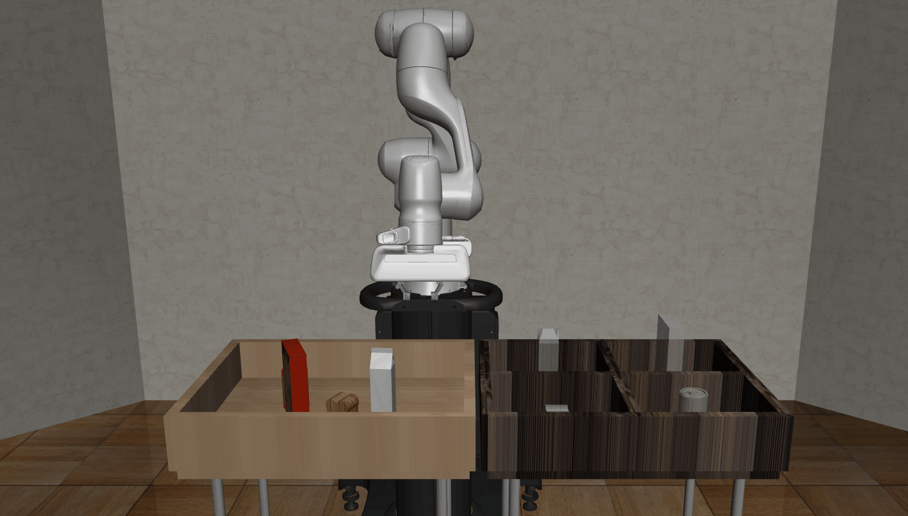
What action to take?
Now that we have established how we make a decision in a given situation, we can start taking actions to reach our goal.
The autonomic nervous system:
Sympathic
Parasympathic
Enteric
But that’s where we leave off for now, let’s look at the robot regarding actions!
Notes:
The autonomic nervous system functions to regulate the body's unconscious actions. The sympathetic nervous system's primary process is to stimulate the body's fight or flight response. It is, however, constantly active at a basic level to maintain homeostasis.^{[4]} The sympathetic nervous system is described as being antagonistic to the parasympathetic nervous system which stimulates the body to "feed and breed" and to (then) "rest-and-digest“activities that occur when the body is at rest, especially after eating, including sexual arousal, salivation, lacrimation (tears), urination, digestion, and defecation.
Consists of a mesh-like system of neurons that governs the function of the gastrointestinal tract; which is a contested devision; but humans like to categorize. Consider it the body of the stomache haha.

Slide 26
Questions?

